Slide 1



learn invent impact
Why this course?
Suresh (Suraj) C. Kothari
Professor, Department of Electrical and Computer Engineering
President & Founder EnSoft Corp.
https://www.linkedin.com/in/surajkothari
Acknowledgement: Team members at Iowa State University and EnSoft, DARPA contracts FA8750- 12-2-0126 & FA8750-15-2-0080

Slide 2
This introductory lecture can help you to understand why this course, and what to learn from it. This lecture presents the first set of concepts without going into all details. Not to worry if you do not understand it fully. I hope it makes you curious and motivated. Full understanding will follow when we revisit and work out more examples to illustrate the concepts.

Slide 3
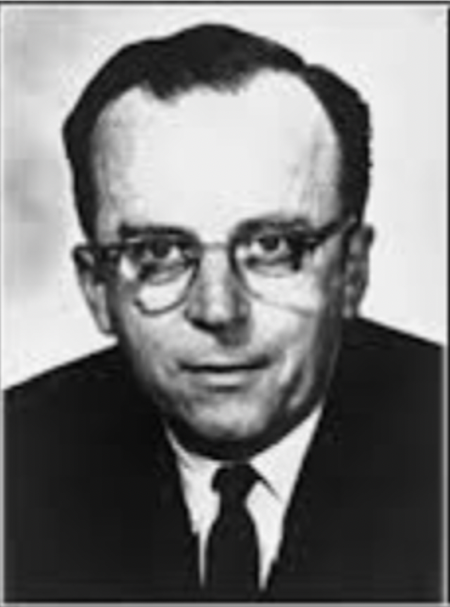
“In a few years, men will be able to communicate more effectively through a machine than face to face. That is a rather startling thing to say, but it is our conclusion.”
J.C.R. Licklider
1960
His Biography: The Dream Machine by M. Mitchell Waldrop

Slide 4
Director, 1962-1964
Information Processing Techniques Office (IPTO)
Defense Advanced Research Projects Agency (DARPA)
J.C.R. Licklider
Both personal computers and the internet can be traced back to the projects J.C.R. Licklider (1915 - 1990) funded at ARPA. He was an original thinker, educated in psychology, and self-educated in information technology. His dream was human-computer symbiosis connected by a global network. JCR supported brilliant scientists through ARPA grants, and their work led to the Arpanet which evolved into the Internet and the personal computer.

Slide 5
JCR Dream = Massively Connected human-computer symbiosis
JCR dream is now a reality – what next?

Slide 6
Unexpected consequences of Internet
Internet
Global Access
Global Access
Limitless possibilities for security breaches
Security Breach
Loss of availability, confidentiality, or integrity
Examples:
Loss of Availability:
Loss of Confidentiality:
Loss of Integrity:
Electric grids go down
Passwords are exposed
Elections are sabotaged

Slide 7
Safety of Software-Driven Systems
Use of software
Efficiency and convenience
Use of software
Software malfunction can cause catastrophic failures
Software
Limitless possibilities for its use as well as failures
Examples of catastrophic software failures:
2018-2021, Boeing 737 Max software problems, two planes crashed
2008, Heathrow terminal software failure, over 500 flights were cancelled
2004, EDS Child support system, erroneous payments costing over a billion dollars
1998, Spacecraft on mission to Mars was lost due to a missed conversion from British to metric units
1996, Ariane 5 rocket exploded due to a numerical overflow error seconds after launch
1982, Russian gas pipeline exploded due to software failure, the biggest non-nuclear explosion

Slide 8
JCR Dream = Massively Connected human-computer symbiosis
JCR dream is now a reality – what next?
We must understand and manage complexity of massively connected systems.
The first set of concepts are about a new way of thinking: how to manage the complexity of software?

Slide 9
Concept 1
Software S = Massive Graph G(S)
With many kinds of nodes and edges
Examples of S
Software (S) | LOC | Nodes in G(S) | Edges in G(S)
XINU (C) | 9602 | 28,778 | 85,729
Linux 5.12 (C) | 24,745,223 | 26,209,786 | 77,262,695
Apache POI (Java) | 1,155,621 | 1,382,194 | 1,445,765

Slide 10
G(S) a graph database for software S
Think of a huge graph database using which we can readily answer all sorts of queries, and perform graph projections to understand, analyze, verify, and transform software S.

Slide 11
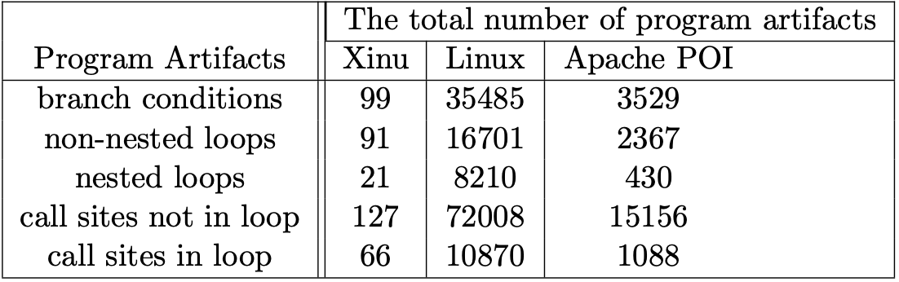
Using G(S) to answer some queries
Example: Counting the number of program artifacts

Slide 12
Projections of G(S)
Projection = Aspect of software
G(S)
projection
G_{C}(S)
Control Aspect
Control is the most fundamental aspect of software – Why?
Concept 2

Slide 13
G_{C}(S): Control Aspect of S
Software (S) | Nodes in G(S) | Control Nodes | Edges in G(S) | Control Edges
XINU (C) | 28778 | 4197 | 85,729 | 4417
Linux 5.12 (C) | 26,209,786 | 1,572,183 | 77,262,695 | 1,598,952
Apache POI (Java) | 1,382,194 | 203,995 | 1,445,765 | 178,020

Slide 14
A mathematical definition for software
Software is a mapping from the space of Boolean vectors to sequences of computations
Software S is a triple:
S^{A}: Set of sequences of computations
A: set of computations
V^{n}: Boolean vectors of some given length (n)
Execution of software: a function (f_{E}) from V^{n} to S^{A}
Concept 3

Slide 15
G_{C}(S) = Compact representation of Execution
n = 3, A = {a1, a2, a3, a4, a5, a6}
f_{E}: Execution of software shown as a table
1
0
V³ |  |  | S^{A}
1 | 1 | 1 | a1 a3 a5
1 | 1 | 0 | a1 a3 a6
1 | 0 | 1 | a1 a4 a5
1 | 0 | 0 | a1 a4 a6
0 | 1 | 1 | a2 a3 a5
0 | 1 | 0 | a2 a3 a6
0 | 0 | 1 | a2 a4 a5
0 | 0 | 0 | a2 a4 a6
a1
a2
G_{C}(S) is the fundamental aspect of S, because:
1
0
a3
a4
Paths in G_{C}(S)
Executions of S
1
0
a5
a6
G_{C}(S)

Slide 16
Execution of Software
Let's look at one more example
n = 4, A = {a1, a2, a3, a4, a5, a6}
f_{E}: Execution of software
EB
00
01
02
03
04
05
06
07
V⁴ |  |  |  | S^{A}
1 | 1 | 1 | 1 | a1 a3 a5
1 | 1 | 1 | 0 | a1 a3 a6
1 | 1 | 0 | 1 | a1 a4 a5
1 | 1 | 0 | 0 | a1 a4 a6
1 | 0 | 1 | 1 | a1 a3 a5
1 | 0 | 1 | 0 | a1 a3 a6
1 | 0 | 0 | 1 | a1 a4 a5
1 | 0 | 0 | 0 | a1 a4 a6
EB
08
09
10
11
12
13
14
15
V⁴ |  |  |  | S^{A}
0 | 1 | 1 | 1 | a2 a3 a5
0 | 1 | 1 | 0 | a2 a3 a6
0 | 1 | 0 | 1 | a2 a4 a5
0 | 1 | 0 | 0 | a2 a4 a6
0 | 0 | 1 | 1 | a4 a5
0 | 0 | 1 | 0 | a4 a6
0 | 0 | 0 | 1 | a4 a5
0 | 0 | 0 | 0 | a4 a6
What does G_{C}(S) look like?

Slide 17
Compact representation of execution behaviors
Check that for every row in the truth table there is a path in the compact representation with the same sequence
n = 4, A = {a1, a2, a3, a4, a5, a6}
C1
0
f_{E}: Execution of software
1
C2
a1
1
0
EB
00
01
02
03
04
05
06
07
V⁴ |  |  |  | S^{A}
1 | 1 | 1 | 1 | a1 a3 a5
1 | 1 | 1 | 0 | a1 a3 a6
1 | 1 | 0 | 1 | a1 a4 a5
1 | 1 | 0 | 0 | a1 a4 a6
1 | 0 | 1 | 1 | a1 a3 a5
1 | 0 | 1 | 0 | a1 a3 a6
1 | 0 | 0 | 1 | a1 a4 a5
1 | 0 | 0 | 0 | a1 a4 a6
EB
08
09
10
11
12
13
14
15
V⁴ |  |  |  | S^{A}
0 | 1 | 1 | 1 | a2 a3 a5
0 | 1 | 1 | 0 | a2 a3 a6
0 | 1 | 0 | 1 | a2 a4 a5
0 | 1 | 0 | 0 | a2 a4 a6
0 | 0 | 1 | 1 | a4 a5
0 | 0 | 1 | 0 | a4 a6
0 | 0 | 0 | 1 | a4 a5
0 | 0 | 0 | 0 | a4 a6
a2
C3
1
0
a3
a4
How many paths?
Are there multiple rows corresponding to same path?
C4
1
0
a5
a6
G_{C}(S)

Slide 18
Multiple rows corresponding to the same path
n = 4, A = {a1, a2, a3, a4, a5, a6}
C1
0
f_{E}: Execution of software
1
C2
C1 C2 C3 C4
C1 C2 C3 C4
a1
1
0
EB
00
01
02
03
04
05
06
07
V⁴ |  |  |  | S^{A}
1 | 1 | 1 | 1 | a1 a3 a5
1 | 1 | 1 | 0 | a1 a3 a6
1 | 1 | 0 | 1 | a1 a4 a5
1 | 1 | 0 | 0 | a1 a4 a6
1 | 0 | 1 | 1 | a1 a3 a5
1 | 0 | 1 | 0 | a1 a3 a6
1 | 0 | 0 | 1 | a1 a4 a5
1 | 0 | 0 | 0 | a1 a4 a6
EB
08
09
10
11
12
13
14
15
V⁴ |  |  |  | S^{A}
0 | 1 | 1 | 1 | a2 a3 a5
0 | 1 | 1 | 0 | a2 a3 a6
0 | 1 | 0 | 1 | a2 a4 a5
0 | 1 | 0 | 0 | a2 a4 a6
0 | 0 | 1 | 1 | a4 a5
0 | 0 | 1 | 0 | a4 a6
0 | 0 | 0 | 1 | a4 a5
0 | 0 | 0 | 0 | a4 a6
a2
R1
C3
R2
1
0
R3
a3
a4
R4
R1
C4
R2
1
0
R3
a5
a6
R4
When C1 == 1, C2 has no effect on the sequences
G_{C}(S)

Slide 19
Multiple rows corresponding to the same path
n = 4, A = {a1, a2, a3, a4, a5, a6}
C1
0
f_{E}: Execution of software
1
C2
C1 C2 C3 C4
C1 C2 C3 C4
1
0
a1
EB
00
01
02
03
04
05
06
07
V⁴ |  |  |  | S^{A}
1 | 1 | 1 | 1 | a1 a3 a5
1 | 1 | 1 | 0 | a1 a3 a6
1 | 1 | 0 | 1 | a1 a4 a5
1 | 1 | 0 | 0 | a1 a4 a6
1 | 0 | 1 | 1 | a1 a3 a5
1 | 0 | 1 | 0 | a1 a3 a6
1 | 0 | 0 | 1 | a1 a4 a5
1 | 0 | 0 | 0 | a1 a4 a6
EB
08
09
10
11
12
13
14
15
V⁴ |  |  |  | S^{A}
0 | 1 | 1 | 1 | a2 a3 a5
0 | 1 | 1 | 0 | a2 a3 a6
0 | 1 | 0 | 1 | a2 a4 a5
0 | 1 | 0 | 0 | a2 a4 a6
0 | 0 | 1 | 1 | a4 a5
0 | 0 | 1 | 0 | a4 a6
0 | 0 | 0 | 1 | a4 a5
0 | 0 | 0 | 0 | a4 a6
a2
R1
C3
R2
1
0
R3
a4
a3
R4
R1
R5
C4
R2
R6
1
0
R3
R5
a6
a5
R4
R6
When C1 ==0 & C2 == 0, C3 has no effect on the sequences
G_{C}(S)

